Slide 1


RESUME CHALLENGE #14
Analysis For Lio-Jotstar Merger

Slide 2

TABLE OF CONTENT
■ Introduction
■ Problem statement
■ Dashboard preview
■ Primary research question
■ Secondary research question
■ Recommendation
■ Conclusion

Slide 3

Microsoft | Power BI
LioCinema and JotStar—
Insights for a Strategic Merger in the OTT Domain
Made by:
Gyan Anand

Slide 4
Lio & Jotstar: Revolutionizing Digital Streaming in India
Company Overview:
Lio, a leading telecommunications provider in India, is planning a strategic merger with Jotstar, one of the country’s most prominent streaming platforms.
This potential partnership aims to combine LioCinema’s expansive subscriber base and Jotstar’s diverse content library, thereby transforming the digital streaming landscape in India.
Merger Preparation & Analysis:
Over the past year (January to November 2024), the management team at Lio has focused on examining the performance and user behavior of both LioCinema and Jotstar. Key areas of analysis include:
Platform performance
Content consumption patterns
Subscriber growth
Inactivity behavior
Upgrade and downgrade trends
Strategic Objectives:
Ultimately, the combined platform—Lio-Jotstar—aims to become India’s leading OTT service, offering unparalleled reach and a diverse content catalog.

Slide 5
Strategic Analysis for the Lio-Jotstar Merger
Purpose:
To unite LioCinema’s expansive subscriber base with Jotstar’s diverse content library, creating a single, market-leading OTT platform that delivers a seamless, personalized, and engaging streaming experience for users across India.
Through data-driven insights and strategic decision-making, the newly merged entity aims to maximize subscriber growth, enhance content offerings, and redefine digital entertainment in the region.
Problem Statement:
Lio aims to merge with Jotstar to create India’s leading OTT platform, yet each service has distinct subscriber bases, content offerings, and engagement patterns.
To ensure a successful post-merger strategy, Lio’s management needs a comprehensive, data-driven understanding of both platforms
Identifying where and why inactivity occurs will help address churn risks.

Slide 6
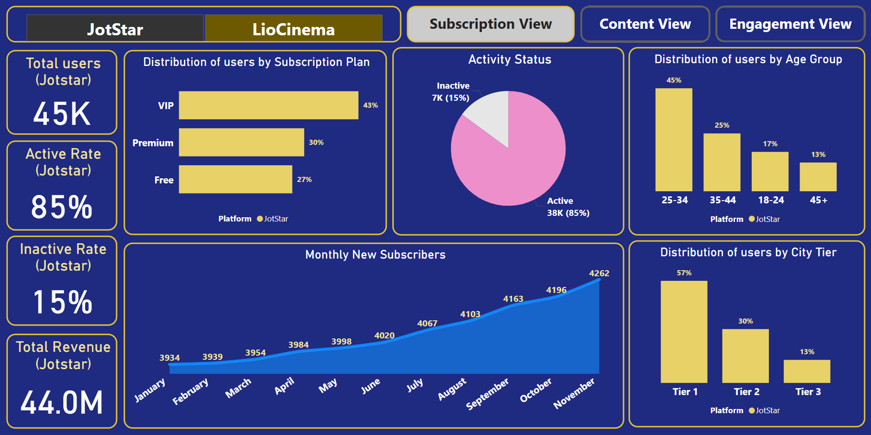

Slide 7
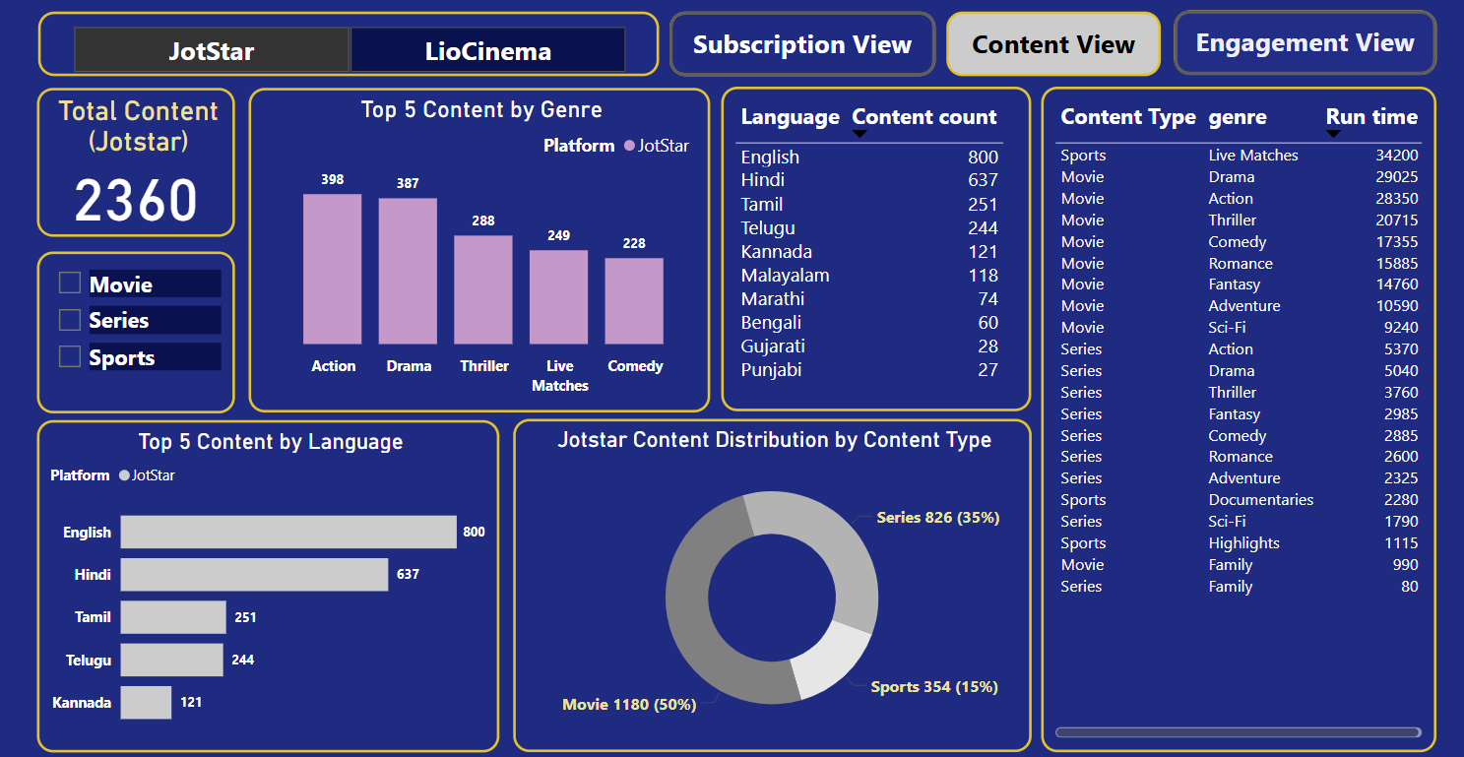

Slide 8
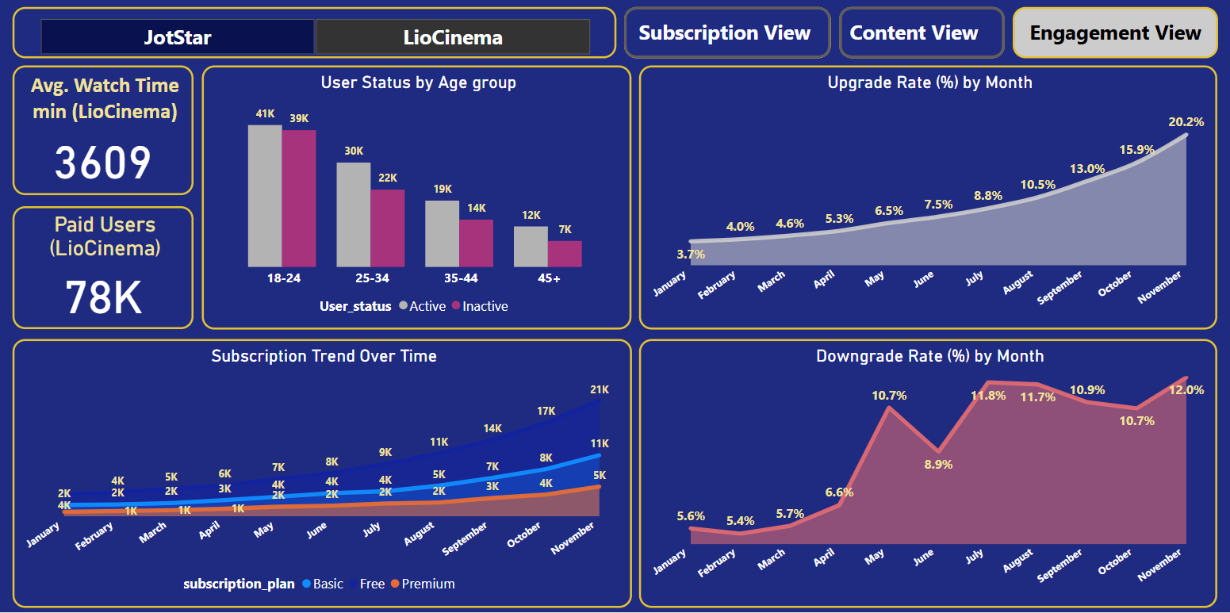

Slide 9
Questions from the available data (Primary)

Slide 10
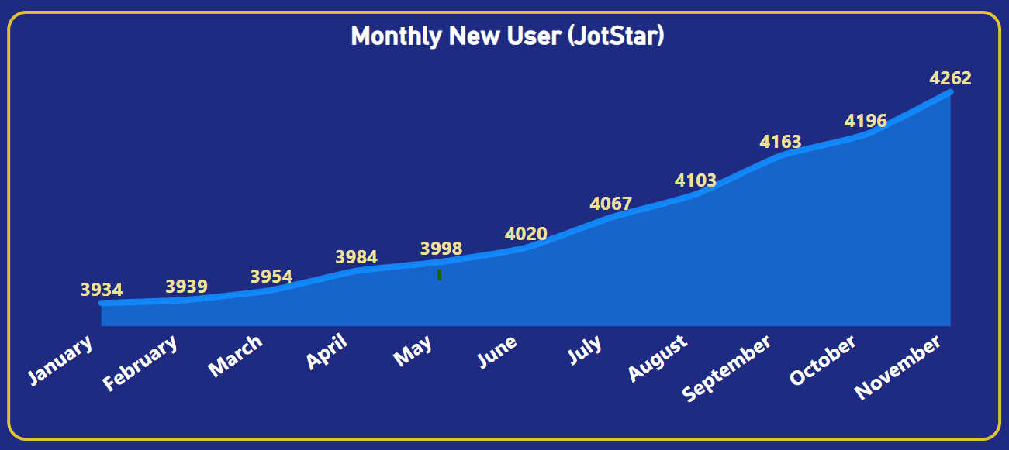
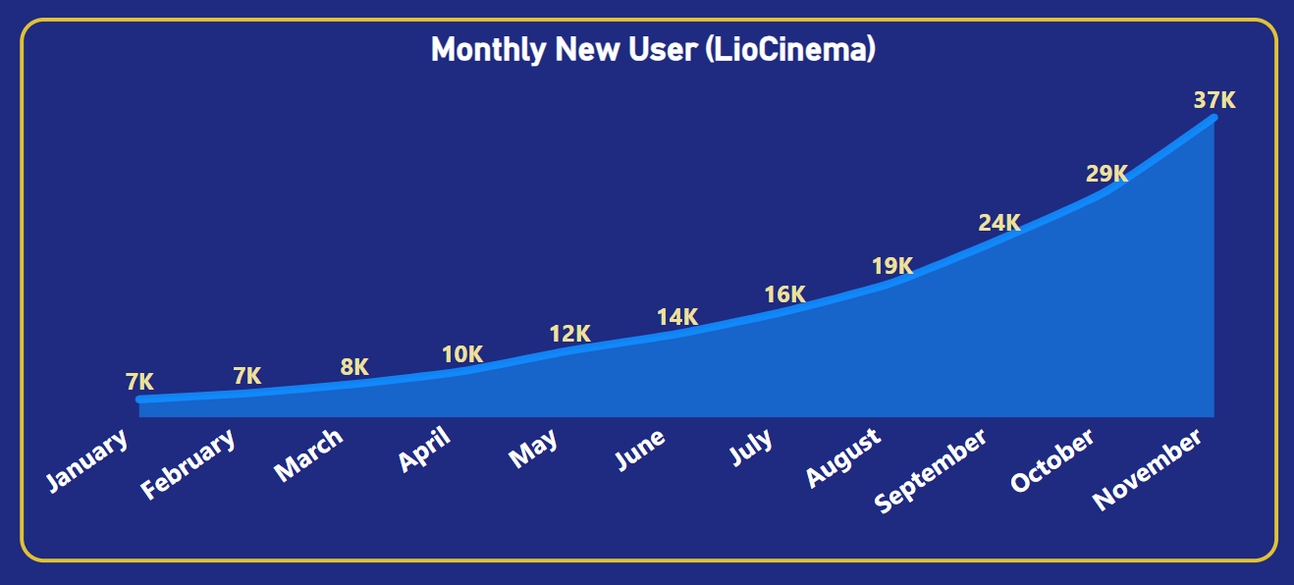
1. What is the total number of users for LioCinema and Jotstar, and how do they compare in terms of growth trends (January–November 2024)?
Month | LioCinema Growth | Jotstar Growth
Jan | 6,758 | 3,934
Feb | 7,404 | 3,939
Mar | 8,397 | 3,954
Apr | 9,759 | 3,984
May | 11,977 | 3,998
Jun | 13,768 | 4,020
Jul | 16,161 | 4,067
Aug | 19,247 | 4,103
Sep | 23,873 | 4,163
Oct | 29,105 | 4,196
Nov | 36,997 | 4,262
Total User | 1,83,446 | 44,620

Slide 11
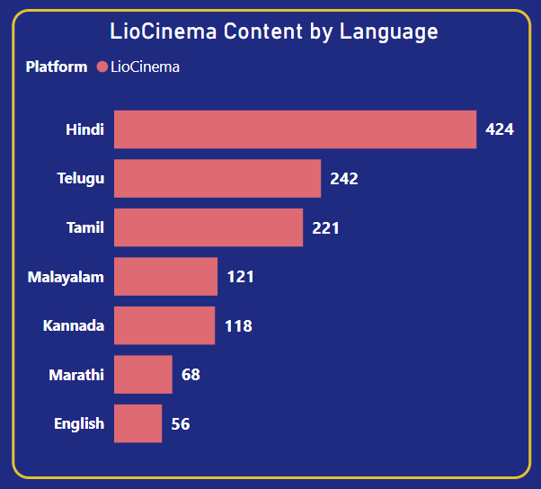
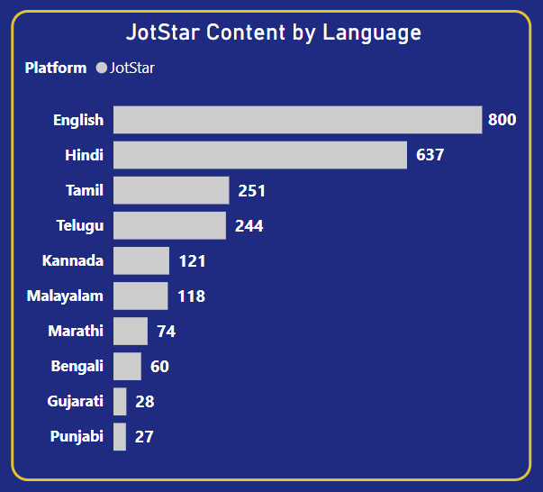
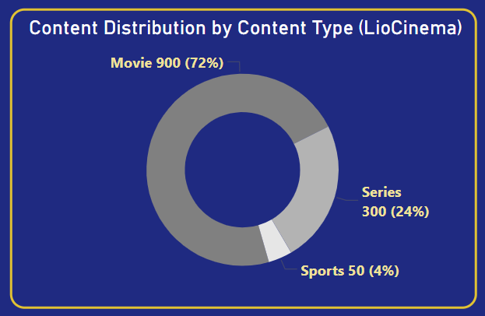
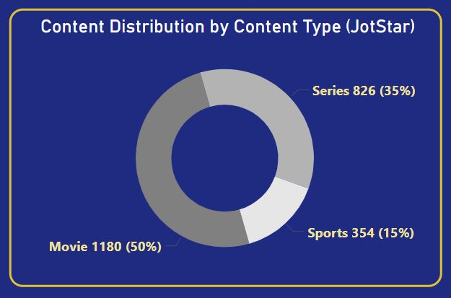
2. What is the total number of contents available on LioCinema vs. Jotstar? How do they differ in terms of language and content type?
Platform | Total Content
Jotstar | 2360
LioCinema | 1250
Final Analysis
✅ Jotstar is leading in total content, language diversity, and content type variety.
✅ LioCinema has a stronger focus on Hindi and South Indian content but is smaller in size.
✅ Jotstar is more balanced with a mix of English, Hindi, regional languages, and sports.

Slide 12
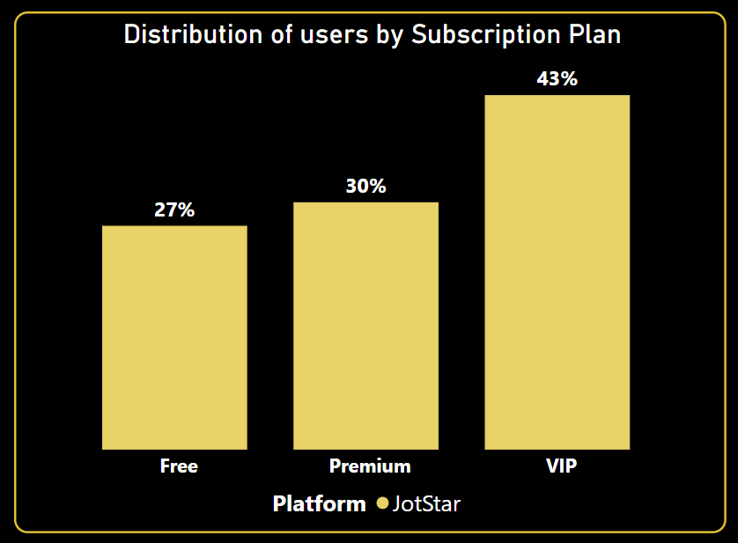
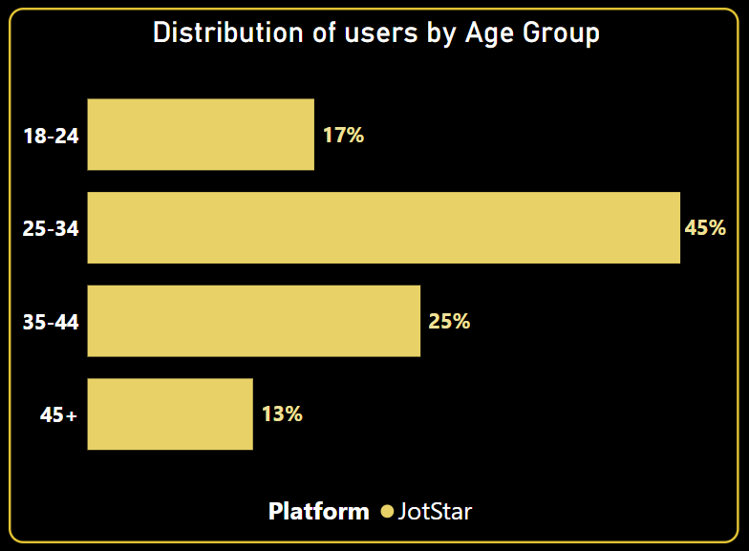
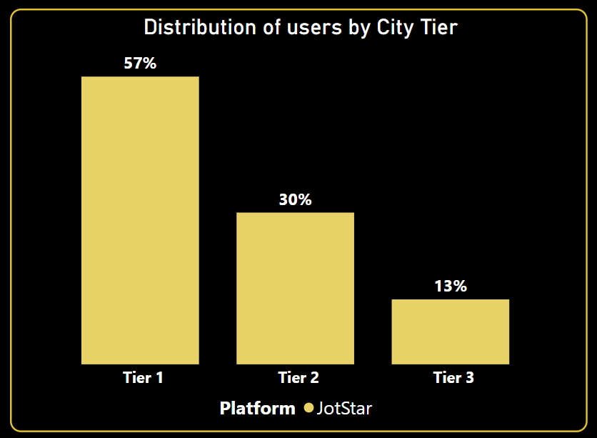
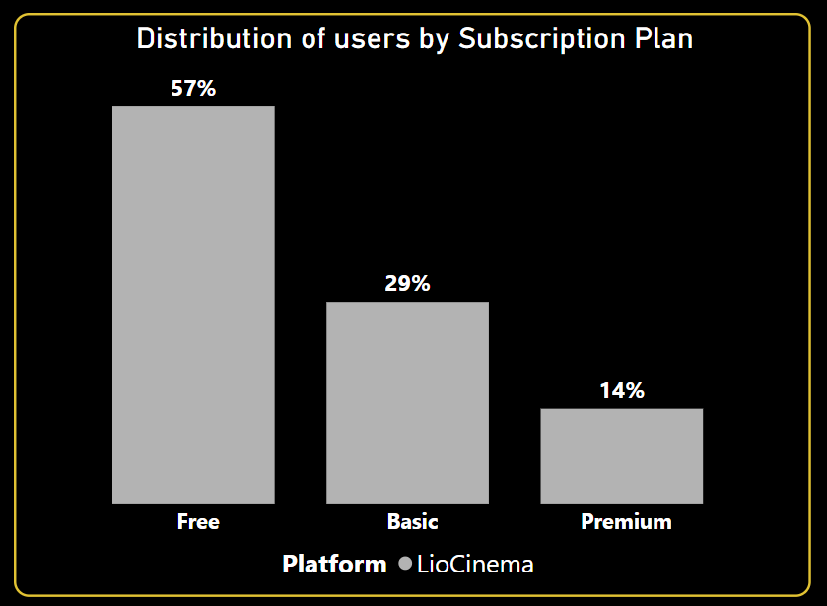
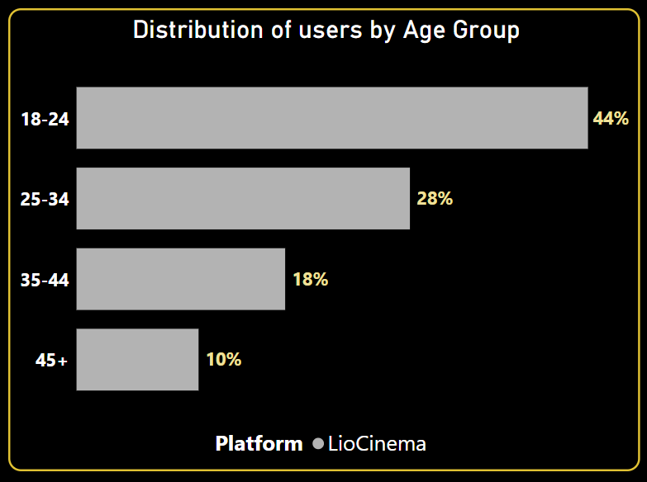
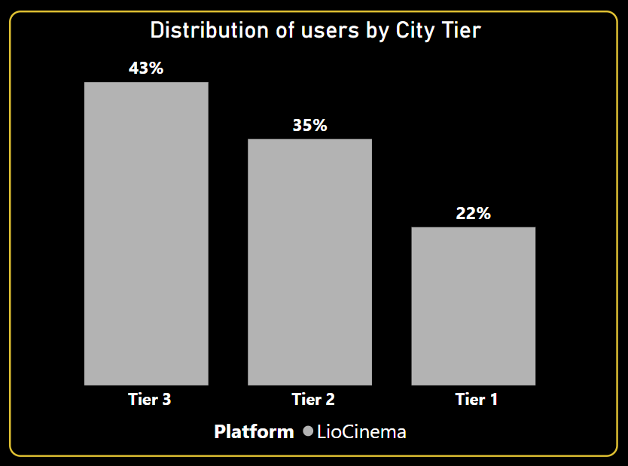
3. What is the distribution of users by age group, city tier, and subscription plan for each platform?

Slide 13
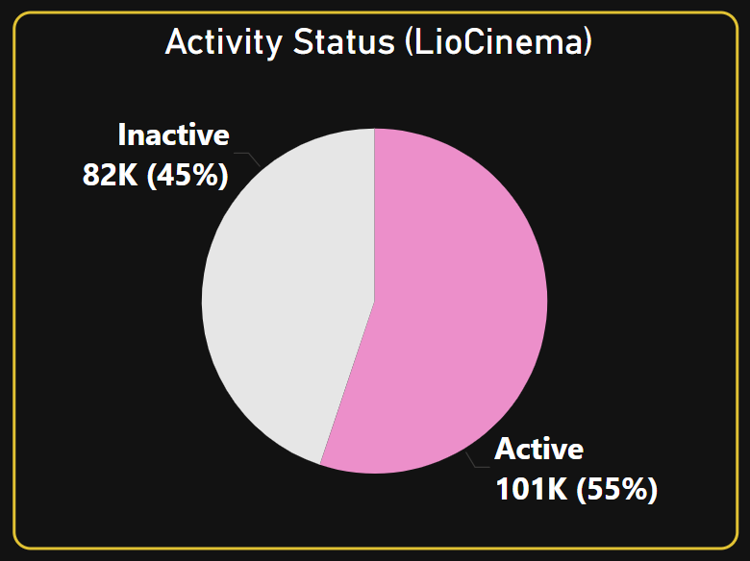
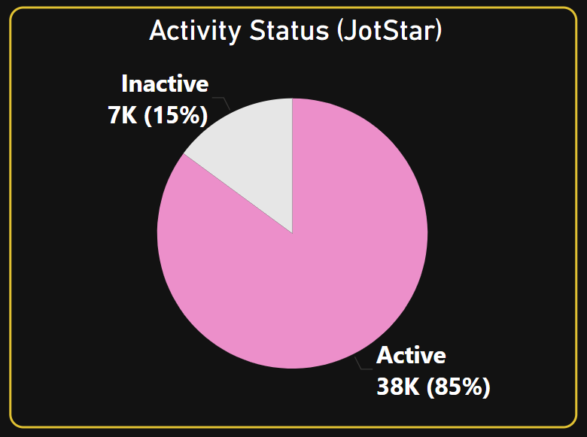
4. What percentage of LioCinema and Jotstar users are active vs. inactive? How do these rates vary by age group and subscription plan?

Slide 14
platform | Age group | Total users | Active users | Inactive users | Active percentage | Inactive percentage
Jotstar | 45+ | 5601 | 4857 | 744 | 86.72% | 13.28%
Jotstar | 35-44 | 11274 | 9688 | 1586 | 85.93% | 14.07%
Jotstar | 25-34 | 20069 | 16944 | 3125 | 84.43% | 15.57%
Jotstar | 18-24 | 7676 | 6479 | 1197 | 84.41% | 15.59%
LioCinema | 45+ | 19046 | 11606 | 7440 | 60.94% | 39.06%
LioCinema | 35-44 | 32560 | 19004 | 13556 | 58.37% | 41.63%
LioCinema | 25-34 | 52027 | 29891 | 22136 | 57.45% | 42.55%
LioCinema | 18-24 | 79813 | 40640 | 39173 | 50.92% | 49.08%
Activity Status by Age Group
platform | Subscription Plan | Total users | Active users | Inactive users | Active percentage | Inactive percentage
Jotstar | Premium | 13367 | 12466 | 901 | 93.26% | 6.74%
Jotstar | VIP | 19157 | 16519 | 2638 | 86.23% | 13.77%
Jotstar | Free | 12096 | 8983 | 3113 | 74.26% | 25.74%
LioCinema | Premium | 25092 | 20609 | 4483 | 82.13% | 17.87%
LioCinema | Basic | 53362 | 35333 | 18029 | 66.21% | 33.79%
LioCinema | Free | 104992 | 45199 | 59793 | 43.05% | 56.95%
Activity Status by Subscription Plan

Slide 15
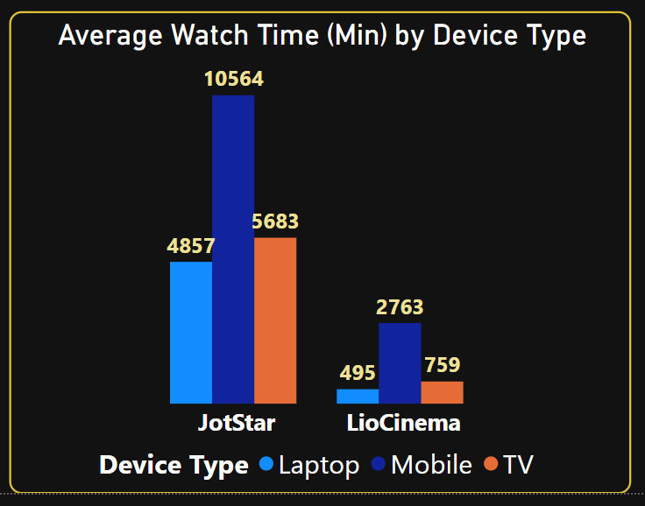
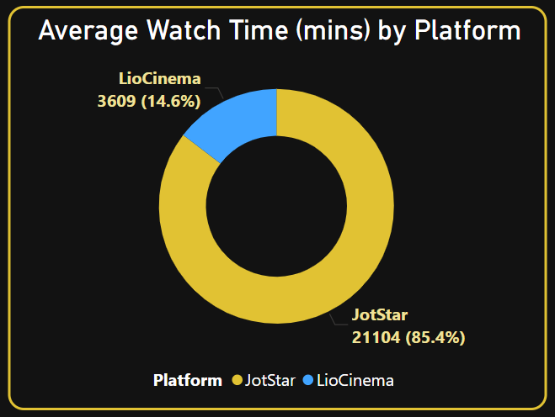
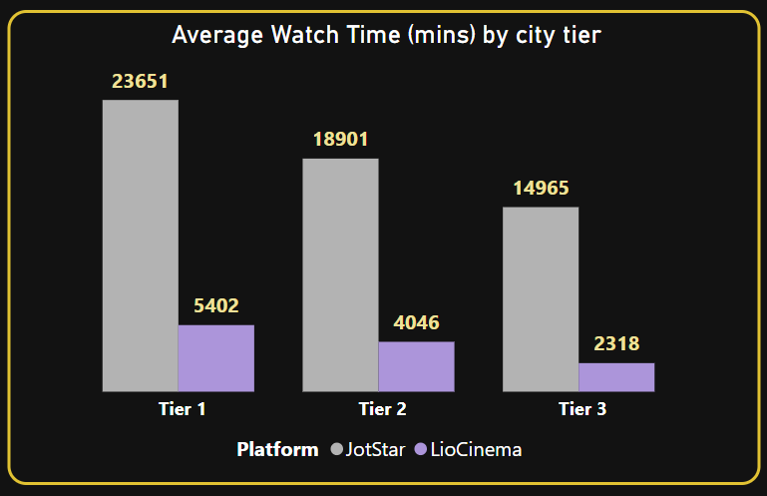
5. What is the average watch time for LioCinema vs. Jotstar during the analysis period? How do these compare by city tier and device type?

Slide 16
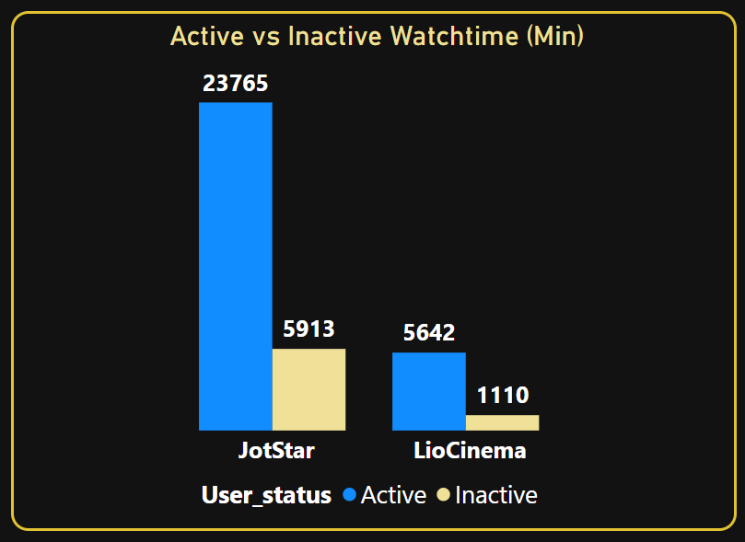
How do inactivity patterns correlate with total watch time or average watch time? Are less engaged users more likely to become inactive?
Platform | Total Users | Active Users | Inactive Users | Inactivity Rate
Jotstar | 44,620 | 37,968 (85.1%) | 6,652 (14.9%) | 14.9%
LioCinema | 183,446 | 101,141 (55.1%) | 82,305 (44.9%) | 44.9%
Are Less Engaged Users More Likely to Become Inactive?
Yes. The data confirms that lower watch time = higher inactivity risk
Jotstar: Users with <6,000 mins watch time (inactive) are 3x more likely to churn than active users.
LioCinema: Users with <1,500 mins watch time (inactive) are 4x more likely to churn.
Lower engagement correlates with higher inactivity rates. Users with below-average watch time are significantly more likely to churn.

Slide 17
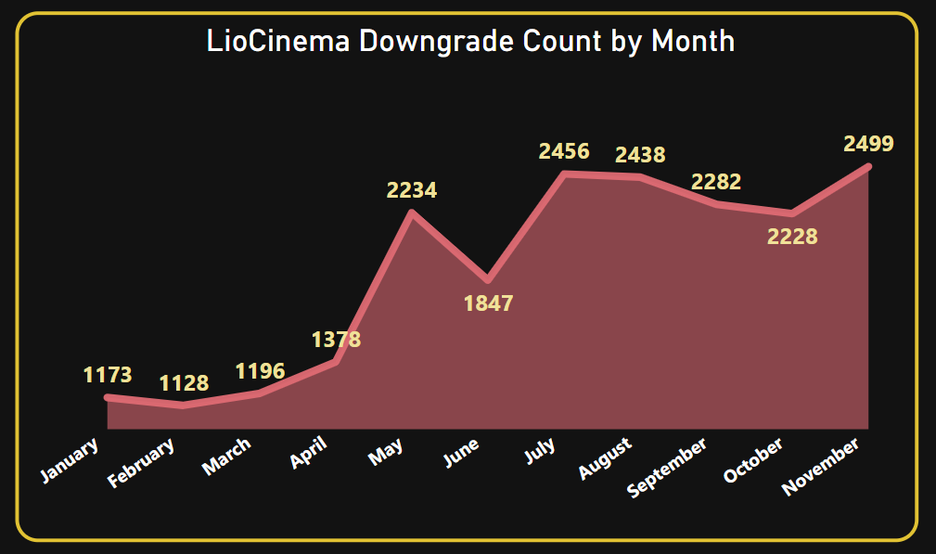
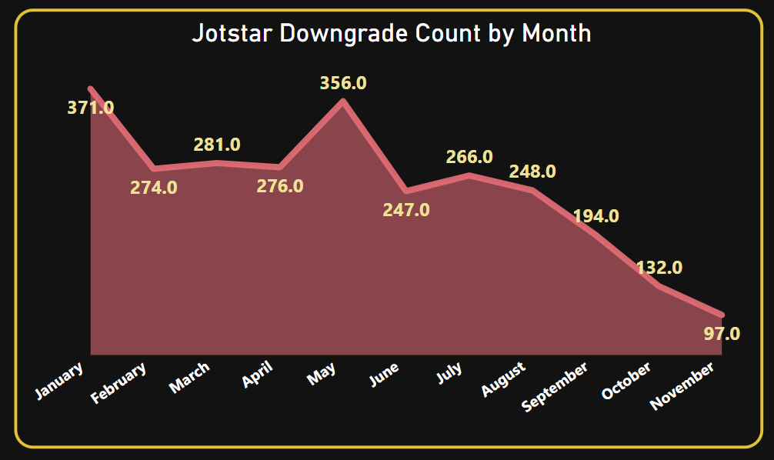
7. How do downgrade trends differ between LioCinema and Jotstar? Are downgrades more prevalent on one platform compared to the other?
Platform | Downgrades | Total Users | Downgrade Rate (Per Platform)
JotStar | 2,742 | 44,620 | 6.15%
LioCinema | 20,859 | 183,446 | 11.37%

Slide 18
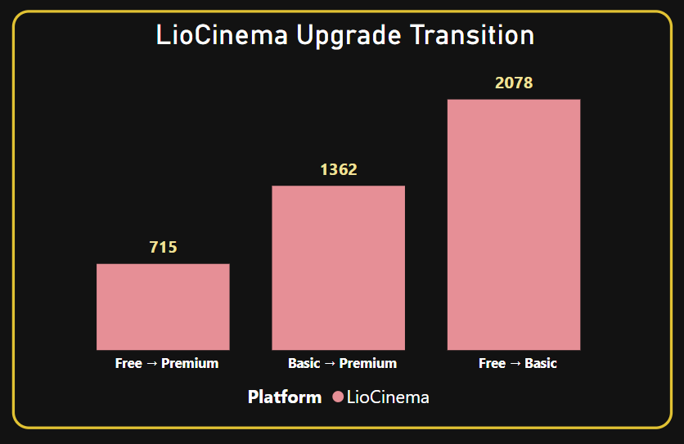
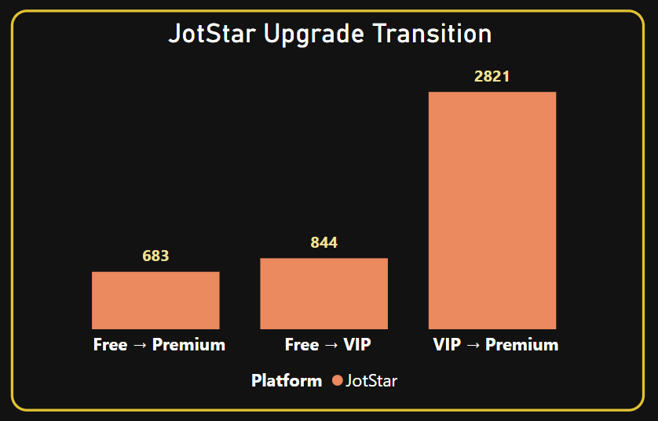
8. What are the most common upgrade transitions (e.g., Free to Basic, Free to VIP, Free to Premium) for LioCinema and Jotstar? How do these differ across platforms?
Jotstar: The VIP tier likely offers exclusive perks (e.g., early access to content), encouraging users to upgrade stepwise.
LioCinema: Basic tier appeals to budget-conscious users, who later upgrade to Premium after testing the platform.

Slide 19
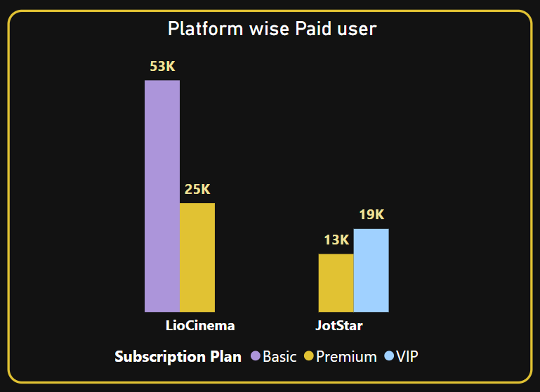
9. How does the paid user percentage (e.g., Basic, Premium for LioCinema; VIP, Premium for Jotstar) vary across different platforms? Analyze the proportion of premium users in Tier 1, Tier 2, and Tier 3 cities and identify any notable trends or differences.
LioCinema
City Tier | Basic | Premium | Total User | (Basic + Premium)
Tier 1 | 12,293 (29.97%) | 10,306 (25.13%) | 41,011 | 22,599 (55.10%)
Tier 2 | 22,570 (35.35%) | 9,090 (14.24%) | 63,848 | 31,660 (49.59%)
Tier 3 | 18,499 (23.54%) | 5,696 (7.25%) | 78,587 | 24,195 (30.79%)
JotStar
City Tier | VIP | Premium | Total User | (VIP + Premium)
Tier 1 | 10,162 (39.93%) | 10,178 (39.99%) | 25,451 | 20,340 (79.92%)
Tier 2 | 6,794 (50.61%) | 2,566 (19.12%) | 13,424 | 9,360 (69.73%)
Tier 3 | 2,201 (38.31%) | 623 (10.84%) | 5,745 | 2,824 (49.15%)

Slide 20
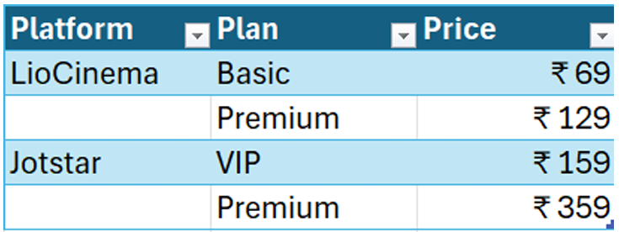
10. Assume the following monthly subscription prices, calculate the total revenue generated by both platforms (LioCinema and Jotstar) for the analysis period (January to November 2024).
The calculation should consider:
❖ Subscribers count under each plan.
❖ Active duration of subscribers on their respective plans.
❖ Upgrades and downgrades during the period, ensuring revenue reflects the time spent under each plan.

Slide 21
Platform | Total_Revenue
LioCinema | ₹ 16,675,418 (16 M)
Jotstar | ₹ 43,952,487 (43 M)
📌 First, let’s talk numbers!
LioCinema has 183K users, while Jotstar has only 44K. That’s a huge difference!
But when we look at revenue, Jotstar dominates with ₹43.95M, while LioCinema is far behind at ₹16.67M.
📌 What’s the takeaway?
LioCinema needs to reduce churn! They should focus on keeping users engaged and upgrading them to higher plans.
Jotstar is winning in revenue per user, but if they want long-term success, they need to increase their subscriber base.

Slide 22
Microsoft | Power BI
LioCinema and JotStar—
Further analysis & recommendations:

Slide 23
1. What strategies can the merged platform implement to increase engagement among inactive users and convert them into active users?
a) Content Relevance & Personalization
Example: Inactive users who last watched Hindi Action movies.
Push notifications for new releases in their preferred genres.
Create Watchlist Recovery campaigns: Your next episode is live!
b) Behavioural Triggers for Reactivation
For users showing a gradual decline in engagement, curate content playlists (Top 10 Action Movies in Your City) to encourage continued viewing.
For users with sudden drop-offs, trigger win-back offers such as a 7-day free trial or limited-time discount to re-engage them.
C) Subscription Plan Optimization
Offer a "Premium Lite" plan at 50% discount for 3 months.
Free users: Promote ad-free Basic plans during peak content seasons.
For free-tier users in lower city tiers, offer tailored promotions such as ₹10/day Basic passes via SMS.

Slide 24
2. What type of brand campaigns should the merged platform launch to establish itself as the go-to OTT platform in India?
Campaign Theme: Ek Platform, Sabke Liye (One Platform for All)
Create a flagship ad series featuring relatable characters from Tier 1 to Tier 3 cities enjoying content in their native languages.
Example: A Tamil father bonds with his Hindi-speaking granddaughter over a dubbed version of Jotstar’s premium series.
Tagline: From Mumbai to Madurai, Your Stories, Your Platform.
Campaign: Apni Bhasha, Apni Kahani (Your Language, Your Story)
Collaborate with regional stars (Allu Arjun for Telugu, Vijay Sethupathi for Tamil) to endorse localized content.
National influencers (e.g. Virat Kohli) to highlight Jotstar’s sports exclusives.
Vote for Your Favorite Classic: Users choose which retro film/series to remake or dub. Winners get VIP access.
3. Affordable Accessibility for Mass Markets
Campaign: Chhota Recharge, Bada Mazaa (Small Recharge, Big Fun)
Objective: Convert LioCinema’s Free users and Tier 2/3 audiences into paid subscribers.
Partner with Lio’s telecom arm: Get 1GB Data + 7-Day VIP Access for ₹49.

Slide 25
3. How should the merged platform price its subscription plans to compete effectively while maintaining profitability?
a) Tiered Subscription Model
Basic Plan: Ad-supported or limited screen access.
Standard Plan: Ad-free, HD streaming, moderate device limits.
Premium Plan: Ad-free, 4K streaming, multiple device access.
b) Bundling, Partnerships & Promotional Offers
Integrate the OTT subscription with mobile data plans.
Co-market via the telecom’s customer base, reducing acquisition costs.
Partner with e-commerce or food-delivery platforms (offer subscription discounts for loyalty program members).
c) Flexible Trials & Discounted Promotions
Offer 7-day free trials to new users in competitive markets.
Use email/SMS campaigns to invite lapsed or inactive users to try new features.
Diwali/Eid/New Year promotions with reduced monthly fees or added months at no extra cost.
Combine promotional pricing with big content releases to drive higher adoption.

Slide 26
4. How can the platform leverage partnerships with telecom companies to expand its subscriber base?
Bundled Subscription Plans
Partner with telecom providers (e.g. Jio, Airtel) to offer OTT subscriptions as part of prepaid recharge packs.
Example: Recharge with ₹249 and get 1.5GB/day + 3 months of OTT Basic Plan.
Integrate OTT subscriptions into postpaid plans (Unlimited 5G + OTT Premium Plan at ₹599/month).
B) Co-Branded Marketing Campaign
Feature telecom and OTT branding in ads (Airtel users! Stream Sacred Games free for 3 months).
Use telecom SMS/IVR channels to push targeted offers (Dial 121# to activate OTT Basic).
C) Regional Partnerships
Collaborate with regionally dominant telecoms (like BSNL in Tier 3) to promote local-language content.
Ex- BSNL users in Bihar: Stream Bhojpuri hits for ₹10/day!
Partner with regional stars (e.g. Allu Arjun for Telugu, Dhanush for Tamil) for localized campaigns.

Slide 27
5. What role can AI and machine learning play in personalizing the user experience and improving content discovery?
i). Personalized Content Recommendations
Analyzes viewing patterns across users to recommend content enjoyed by similar audiences (Users who watched Movie A also liked Movie B).
Suggests content based on attributes like genre, actors, or directors aligned with a user’s historical preferences (prioritizing comedies for a user who frequently watches them).
Combines collaborative and content-based approaches for more accurate recommendations, addressing the "cold start" problem for new users by using demographic or initial preference data.
ii) Adaptive Streaming and Accessibility
Recommends dubbed or subtitled content based on language preferences or geographic location.
Allows users to adjust recommendation settings (Why am I seeing this?) to build trust.
Ensures recommendations avoid over-representing specific genres or demographics (balancing regional and mainstream content).
Tailors the homepage to highlight genres, trending shows, or formats (mobile-friendly short videos for users on smartphones).

Slide 28


6. Who should be the brand ambassador for the newly merged OTT platform (LioCinema-Jotstar) to effectively represent its identity and attract a diverse audience?
Allu Arjun Virat Kohli

Slide 29
Top 3 Recommendations for the Lio-Jotstar Merger
Integrate Content Libraries & Regionalize Premium Offerings
Redub Jotstar’s premium series/movies into regional languages (Tamil, Telugu, etc.) for LioCinema’s Tier 2/3 users.
Offer a Premium+Regional plan (e.g., ₹199/month) combining Jotstar’s sports/originals with LioCinema’s regional hits.
Streamline Jotstar’s live sports (e.g., cricket) on LioCinema’s app to attract Tier 1 users.
2. Launch Tiered Pricing & Retention Campaigns
Tier 1: Premium plans with 4K/family packs (₹359/month).
Tier 2/3: VIP Lite plans (₹99/month) for ad-free regional content.
Target inactive users with free trials of Jotstar’s exclusives .
3. Leverage Unified Data Insights for Hyper-Personalized Experiences:
Unified User Profiles: Merge telecom (Lio) and streaming data for personalized offers (Watch on Mobile, Continue on TV).
Inactivity Alerts: Trigger push notifications with tailored content for users with <1,000 mins/month watch time.

Slide 30
Conclusion
The merger of LioCinema and Jotstar presents a transformative opportunity to redefine India’s digital streaming landscape by combining mass-market reach with premium content excellence. By strategically integrating their strengths, the unified platform can achieve unparalleled growth and user retention through three core pillars:
Regional Localization + Premium Exclusives: Merging LioCinema’s regional dominance (Tamil, Telugu) with Jotstar’s premium English/Hindi content will cater to Tier 1–3 audiences, driving engagement across demographics.
Live Sports & Hybrid Bundles: Leveraging Jotstar’s sports catalog and LioCinema’s telecom infrastructure will attract urban users while retaining regional loyalty.
Pricing & Premium Lite Plans: Affordable daily/weekly packs (e.g., ₹10/day) for Tier 2/3 users and discounted annual subscriptions will convert free users and reduce inactivity.
City-Specific Offers: Tailored plans like "Tier 2 Premium Lite" (₹99/month) will bridge affordability and premium access.
Unified User Insights: Combining Lio’s telecom data with Jotstar’s engagement metrics will enable hyper-personalized recommendations, reducing churn and boosting watch time.
AI-Powered Retention: Targeted campaigns for inactive users (e.g., free trials of exclusives) will revive engagement.

Slide 31


